Slide 1
Communism, Cartels, & Compromise
Cesar Gaviria’s Cabinet
Slideshow template courtesy of SlidesGo
Notes:
The perspective of this committee occurs from the role of the Minister of Communications, who has control of media and outlets. This slideshow is meant to give an exemplar of how crisis committees work, as it took place in a completely virtual conference setting.

Slide 2
INTRODUCTION
After a constitutional reformation by Cesar Gaviria’s government in 1991, the cabinet ministers are left to deal with issues such as drug trafficking (and hippo trafficking too), paramilitary groups, and the conflict between communism and capitalism.

Slide 3
#1
Escobar’s Escape

Slide 4
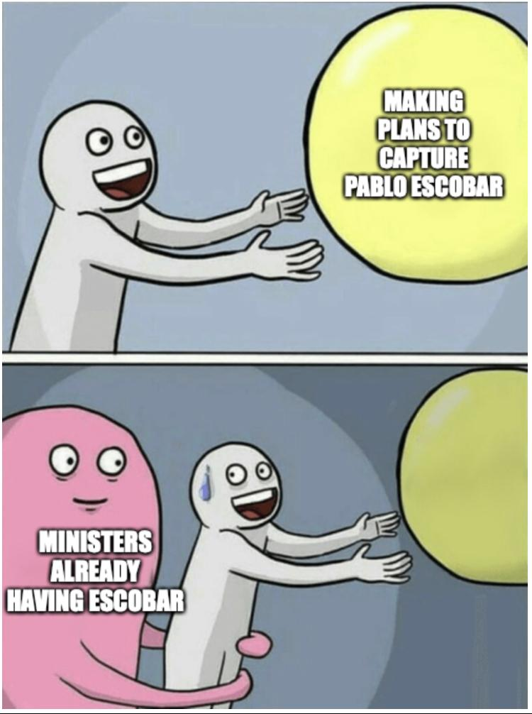
Crisis #2: After three directives are passed
Notes:
While all the ministers were trying to capture Pablo Escobar, there were two ministers that already had him in custody… but how?

Slide 5
Update after three directives passed:
Three ministers want to involve the US troops, going against the constitution and the remaining ministers’ wishes.
Unbeknownst to all the ministers, the three on board with US involvement are planning to assassinate half of the cabinet to get their directives passed.

Slide 6
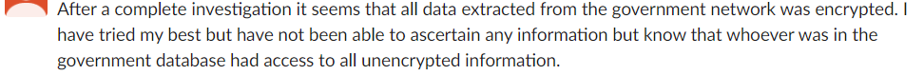
Crisis update #3:
Someone has bypassed the cybersecurity system and all encrypted information is in the hands of a third party.
Meanwhile: people are unhappy with the economy, and it looks like the government will not be re-elected again.

Slide 7
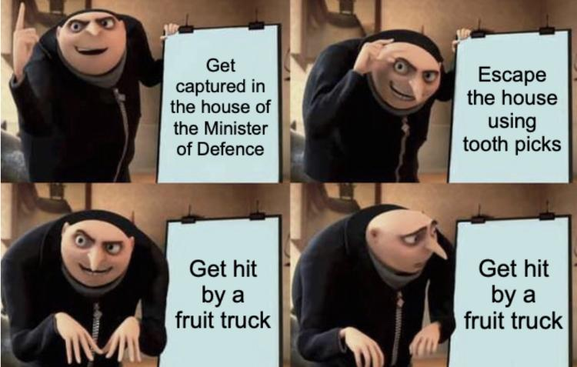
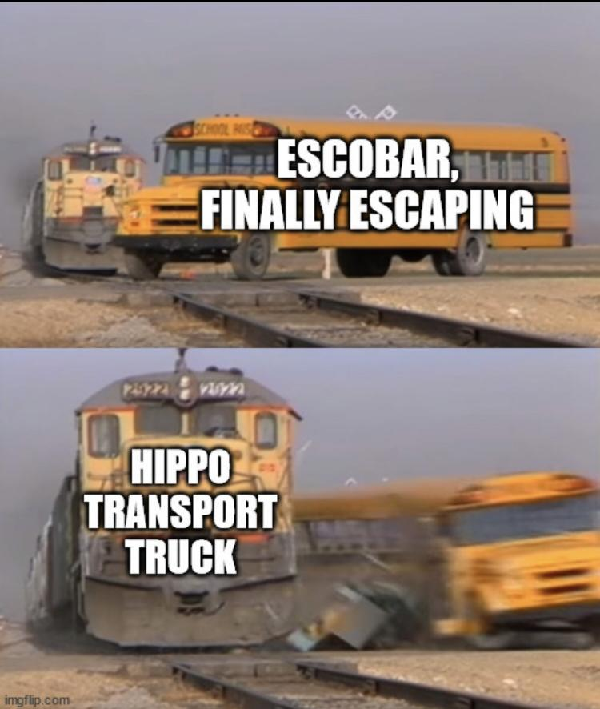
Crisis Update #4
Notes:
Pablo Escobar is dead!

Slide 8
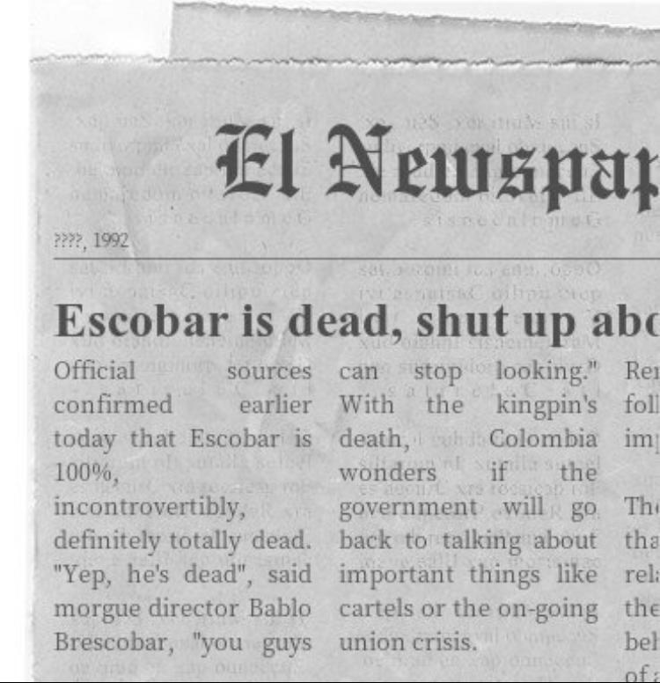
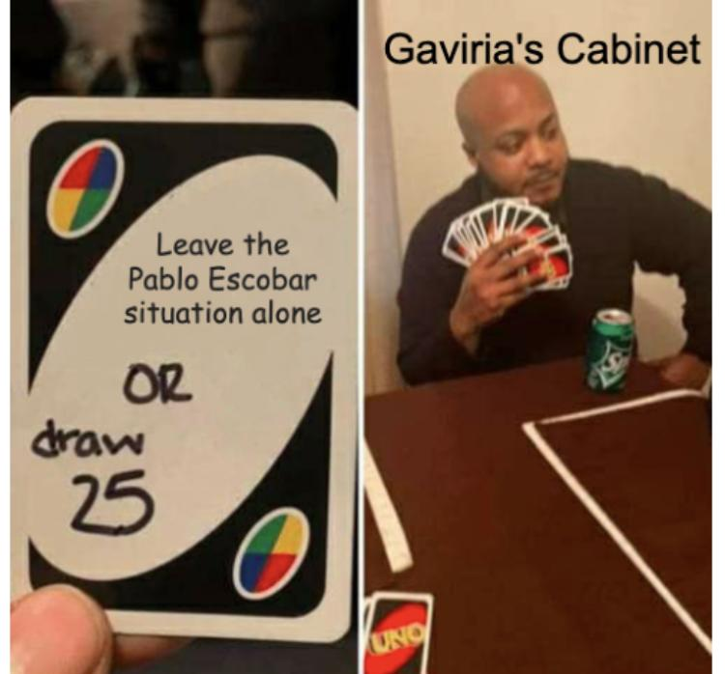
Crisis Update #4
Notes:
Here, we were being told by the crisis staff to stop discussing this issue and move onto more pressing matters in the cabinet, such as the uprising of civilians, armed militia groups, and Indigenous people. And maybe, just maybe… the kidnapping of an American.

Slide 9
US troops stationed at Colombia’s border
Crisis Update #4

Slide 10
Crisis Update #4
News reporter: Why are you disappointed at Gaviria’s cabinet ministers?
Civilian: Basically they’re going against their very own constitution they worked so hard to establish. Also, Escobar escaping twice? This government is terrible.

Slide 11
Crisis Update #5 - three directives later...
News reporter: we are gathered here today to mourn over Pablo Escobar’s funeral.
Also the news reporter: we are gathered here today to celebrate the marriage of the Minister of Transport and Maria Victoria Henao, Pablo Escobar’s former wife.

Slide 12
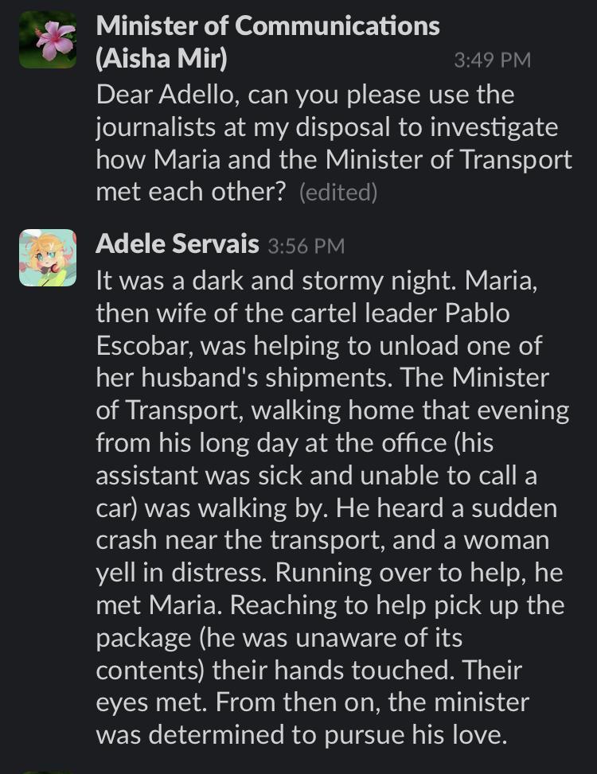
Investigation Time!
Another investigation update: After conducting thorough investigations, there was suspicious activity at the Minister of Defense’s house regarding Pablo Escobar’s stay.

Slide 13
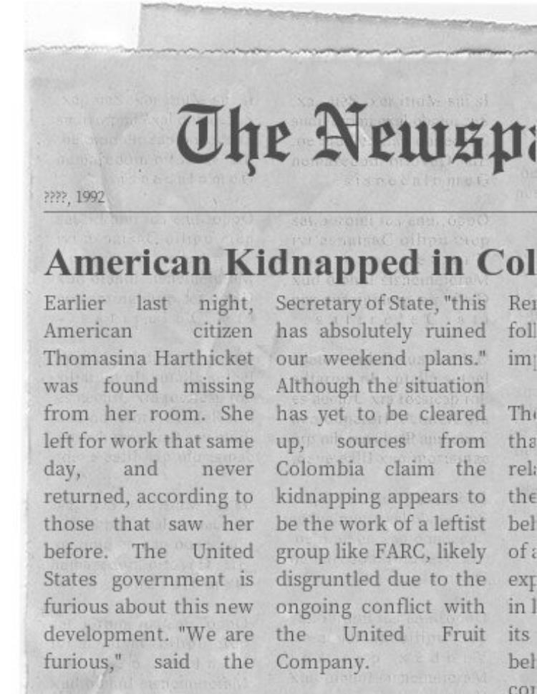
Crisis Update #6
Blackout crisis: 20 minutes to draft a directive or else the FARC will not hand over the citizen. They will release the her on the condition that the cabinet ministers force the United Fruit Company to go out of business.

Slide 14
Crisis Update #7 - after four directives are passed
Committee in Unmoderated Caucus: Wants to get rid of Minister of Defense for being an accomplice to Escobar’s escape.
Three ministers in back-room: Kill off the Minister of National Education and detain all the remaining ministers, with their own paramilitary coup.
THE END.

